Slide 1
DITAP
Iteration 2A
Digital Services in the 21st Century Government

Slide 2
Release 2:
Understand what you are buying
Notes:
Going to ask them a prompt and pair them up to discuss for 10-15 mins -- what should it be?
“How can
If you know an agency you are working with is at level 1 and you hear them at level 5- what do you do?

Slide 3
Understanding what you are buying
In order to effectively buy Digital Services, you need to be able to clearly understand them. We’ve started disecting what they are and what they are not, and what they mean.
You’ve been buying them and working in them, whether you realized it or not, for longer than most, now we’re merely bringing structure to the process.
Making the process more predictable and manageable overall.
Notes:
End users take a slice of the information layer likely every day when they look up information and images, or complete forms online or on a mobile device.

Slide 4
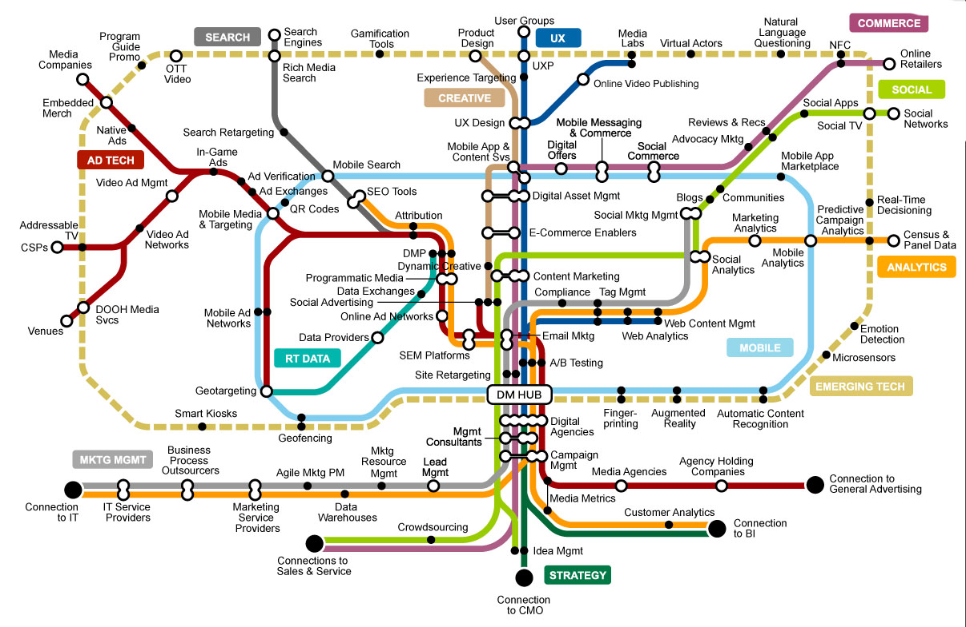
Understanding what you are buying
Notes:
End users take a slice of the information layer likely every day when they look up information and images, or complete forms online or on a mobile device.

Slide 5
DS Principles
The focus of this release is the customer and their needs.
We already made progress by learning about stakeholder mapping, which allows us to explore and distinguish between:
needs,
(contract) requirements, and
outcomes.
Notes:
End users take a slice of the information layer likely every day when they look up information and images, or complete forms online or on a mobile device.

Slide 6
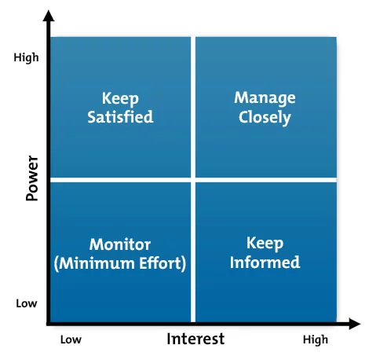
DS Principles
Notes:
Understanding the needs of stakeholders supports the development of your acquisition solution. You'll consider what you learn from your stakeholders while surveying technical contracting details like requirements documents, cost and pricing strategies, terms and conditions, and evaluation tips and tricks.

Slide 7
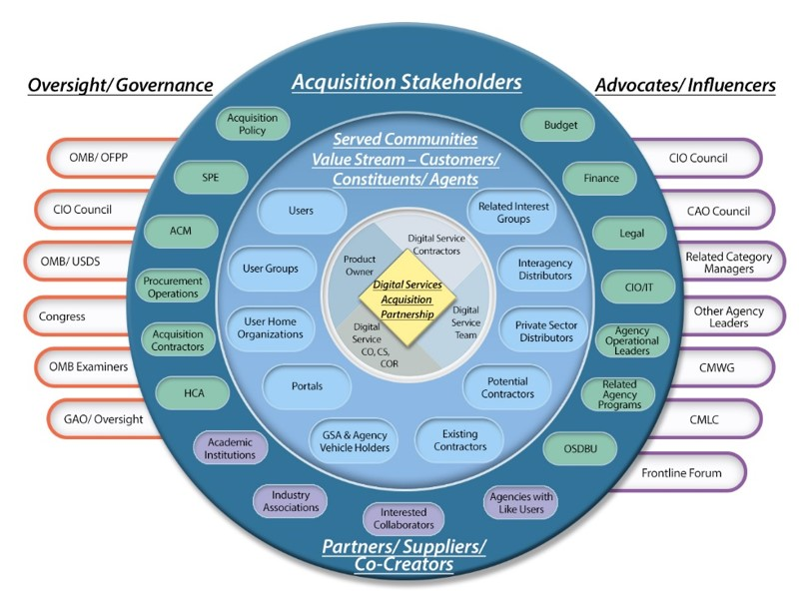
Navigating the stakeholder landscape
Notes:
So Is This Really All that Different from How I Have Traditionally Engaged My Stakeholders?
The sample Stakeholder Landscape map below depicts the range of stakeholders you may need to engage with to bring your acquisition plans to fruition. It is not all-inclusive, but is designed to get you thinking about some of the players you may need to get involved and how to engage them. This map places various stakeholders within specific categories, but it may not always be this clear cut! An individual’s role in the acquisition may extend across more than one category. For example, while the Head of Contracting Activity (HCA) may fall primarily in the Acquisition Stakeholder category, the HCA may also perform oversight function; furthermore, depending on the HCA's place and mission in the organization's structure, he or she could also be an Influencer. Each role or function not only has different impacts on the acquisition, but also presents different engagement considerations and informational needs. You should adjust your engagement content and strategy to maximize the beneficial effect of that person or entity's role and impact on your acquisition.
While some of this may parallel your stakeholder work on traditional contracts, digital services contracting places even greater demands on stakeholder engagement because you’ll likely be asking the program and procurement functions to do something different. Aligning the key stakeholders with your acquisition plans and strategies is critical. Let’s start with the map and the big picture:
Digital Services Acquisition Partnership – At the center of the stakeholder map are your collaborators and co-creators for the digital services product/service and its contract support – the team responsible for developing the procurement and making it all work to support digital services delivery.
Served Communities and Customers/Constituents/Agents – Agile and human-centered design both start with the customer/user context, needs, and desires in mind. Through ethnographic interviews, personas, and other methods, digital services teams craft their designs and product/service iterations based on a deep understanding of the customers and their environment. Though this understanding is usually left to the product owners and developers, it will serve you well to develop an understanding of the customer context to do your job in contracting. This circle represents these customers/users and those agents or functions providing direct service or support to those customers.
Acquisition Stakeholders – The offices/divisions that impact the go/no go for digital services contracting as well as the contracting operational support essential to prepare for, award, and manage the contract. In today’s digital service projects this go/no go doesn’t happen just one time. The green circles represent the acquisition stakeholders within your agency.
Partners/Suppliers/Co-Creators – The supporters of your product or service who can be essential to the acquisition lifecycle. They offer insight and support based on their experiences or share in the co-creation. These individuals are represented by purple circles on the stakeholder map.
Oversight/Governance – The external organizations whose policies and regulations can impact how you run a procurement to support the project. They ensure compliance with existing law and regulation, but also can be a means of support to implement a procurement that is not common practice but still within the law, regulation, and policy.
Advocates/Influencers – The potential senior-level champions who can help build buy-in for the acquisition strategy. They can also offer avenues to accelerate and simplify (e.g., Government-wide Category Managers and the Acquisition Gateway may provide some of the means and methods to implement your procurement more easily).
Though all of these stakeholders are important in the acquisition landscape or ecosystem, their interests and concerns vary widely depending on the type of procurement, what is common practice in your agency, what you may be asking the agency to do, and the stage in the acquisition lifecycle. For example, imagine your acquisition strategy entails considering a procurement for research funding to explore the options in ergonomic interfaces for a digital services offering. If your agency is not used to this kind of a procurement, you’ll likely need to engage with your Senior Procurement Executive, HCA, the contracting organization chain of command, and Office of General Counsel early in the process. For a more common procurement, you may not need to engage with them at all, depending on your own agency’s policies and procedures.

Slide 8
Understanding what you are buying
By their nature, digital services typically have a user on the other end.
But who is this person, and what do they do?
Maybe the more important question is, what do they need to help them do it better?
Many times, especially in government, the solution lies somewhere between what a customer needs and what his or her requirement is because these are not always the same.
Notes:
However, if you can navigate this space, the chances that your acquisition outcome supports the end user’s need will vastly improve. Our self-directed program for this iteration is all about understanding the requirement vs. the outcome. You will study how the requirements development process makes communicating the need challenging. Through this study, it is our hope that you begin to appreciate where you can use the acquisition process to support value creation in a responsible and compliant manner.

Slide 9
Stakeholder analysis:
Interviewing intensive
Notes:
Situation 1: You’re working on a digital services procurement and need to answer the question, “Who is my customer?” That’s easy, you think. It’s the program office or the program owner - the visionary and champion for the product or service. But wait a minute. Is that always the case? Are they the end users who will use the product or service – for instance, the individual who is in charge of entering data into a system, the citizen using your website to learn more about energy efficient products, or the government team that is the primary user of the tool being developed? The answer to this question will drive how you approach the acquisition. End users should drive your technical and design decisions – so get them involved in the process! This sounds simple in theory; however, it’s not so simple in execution, particularly when you have other stakeholders – budget, acquisition policy, CIO/IT, and vendors and contractors – who feel strongly about the design and execution of the product or service.
Situation 2: You’ve spent months putting together an acquisition plan and getting various stakeholders to review and provide feedback along the way. All of a sudden, a new stakeholder—one you hadn’t thought to include to date—provides feedback that requires you to significantly adjust your approach. Frustrated, you think, “If only I had thought to get them on board and involved earlier on, we could’ve had a better product and have saved time and money.” We can probably all relate to a time (or times!) when this has happened and the frustration we felt as a result.
So how do you plan for involving your customers and engaging all stakeholders at the right time in the right way? That’s where this activity comes in!
Why Is Stakeholder Engagement So Critical on Digital Services Efforts?
According to Agile theory and the TechFAR, it’s critical to bring together the “right” cross-functional team of high performers in order to take on the frequently evolving, rapid pace of digital projects. In addition, “Big A” acquisition methods advocate for broad inclusion of agency leaders, managers, acquisition policy, and oversight functions in the acquisition lifecycle.
As a function that, in part, is responsible for reducing the risks of legal, regulatory, financial, and compliance exposure in contracting, acquisition resists the unfamiliar and uncertain. Acquisition strategies you may want to pursue in digital services may attract greater scrutiny merely by the fact that they are not common practices in the agency, even though they are legal and adhere to acquisition regulation and agency procurement policy.
To get your stakeholders comfortable with your approaches, you should anticipate a high level of interaction between agency team members, contractors, and other stakeholders. But how do you identify who you should talk to? And, once you have identified them, how and when do you engage with them?

Slide 10
Stakeholder analysis:
Practice what you preach
Notes:
Introduction: In this activity, it’s your job to hone in on the individuals within your agency you believe are major influencers or gatekeepers in the digital services acquisition process and develop a strategy for engaging with them. You’ll use your experiences with this program as a springboard for the conversation.
Activity Goal: By completing this activity, you will:
Gain a better understanding of your agency's readiness for change and innovation,
practice influence conversations, and
build your digital services network
Instructions – Part 1: Prepare: For Part 1 of this activity, you’ll identify 2-4 people within your agency that you don’t normally have a chance to interact with but who you see as a major influencer or gatekeeper (e.g., CIO, HCA, CAO, SPE, CFO, Policy Office leader). You may want to create a map (in Visio, PowerPoint, or another mind mapping software) like the sample Stakeholder Landscape on the previous tab but refine it to mirror the specific stakeholders you need to engage. This will help you see the potential pool of stakeholders and aid you in narrowing your selection.
Narrow down your list to 2-4 key stakeholders based on the following assumptions:
The greatest perceived level of influence or control over the progress of digital services procurements (stakeholders differ in their level of influence and control)
Their perceived level of influence or control over the progress of acquisition generally in the agency
Their potential involvement in your role as a future agency ambassador for digital services acquisition
2. Do some basic research on the person and develop hypotheses that you would like to test during the conversation. Think of this conversation as a starting point to test your assumptions about their influence in the digital services acquisition process and their role in leading change and innovation in your agency. Basic considerations:
Position
Years in position
Relationship of the other person to me
Span of responsibilities
Work history
Personality
Strengths/Weakness
Formal/Informal roles in the acquisition lifecycle
Formal/Informal connections and relationships with other primary stakeholders
3. Hypothesize potential benefits and challenges to their engagement in digital services acquisition. Below are some example hypotheses you can develop about your stakeholders:
Their role can positively affect digital services acquisition in the future. Explore the interconnections between their goals and creating agile acquisition methods that are faster, improve quality, and improve outcomes.
What is their influence over the acquisition process and in what parts of the process do they play approval, advisory, or recommendation roles?
Leaders and stakeholders are called on to lead change and innovation in their agencies. What change or innovation efforts have they been involved in? What lessons can we learn from those initiatives that will benefit digital services acquisition?
Change raises issues and concerns in agencies regarding risk, ability to meet mission, cost and financial impacts, employee satisfaction, culture, and other factors. Agile digital services acquisition is a change for the agency in the ways it identifies needs, conducts the acquisition process, works with contractors, and iteratively achieves outcomes. What concerns do they have regarding the changes necessitated by the agency embracing digital services acquisition?
4. While the main goal of this conversation may be to learn about the influencer or gatekeeper, this individual will also be forming their own impression of you. Think about how you would like to position yourself and what influence you will have on this person.
Anticipate possible questions the person may have about your background experience – depending on the stakeholder, you may have greater expertise in agile and acquisition innovation than your stakeholder does.
Take time to review the online learning module on influence to learn about different approaches to the conversation.
Try to identify whether or not the influencer or gatekeeper may become a future advocate or champion for agile and digital services acquisition.
5. After you finish brainstorming, use the second page of the Stakeholder Holder Interests template (below) to develop your conversation structure. Taking time to complete this information will help you feel more prepared for the conversation. You can use the following resources to help you prepare for the interviews:
Use the Stakeholder Interests Template to identify opportunities and challenges in working with stakeholders and to establish a framework for your interview with a stakeholder.
Use the Stakeholder Interview Guide Template to identify questions to ask your stakeholders.
For your interview, keep in mind the following:
Purpose: Why are you having this conversation? What are you trying to achieve?
Structure: How will I open the conversation? What strategies will I use during the conversation? What does success and next steps look like?
Resources: What information do you need to gather to prepare for the conversation?
6. Practice your conversation with a member of the cohort and enlist their feedback. Use their feedback to polish your engagement strategy.
Definition of Done & Deadline for Completion: Part 1 must be completed in Release 2. By the end of Release 2, you will need to provide a word document that includes:
The identified stakeholders you intend to interview
Status of scheduling those interviews
Your list of questions you plan to ask

Slide 11
Sources of supply:
The suppliers

Slide 12


The suppliers
Notes:
Now that we have segmented the marketplace and understand more about what each segment provides to us as the consumer, it is time to consider the suppliers themselves. What do you think it’s like to sell services to the government?
First, you must get registered to do business by working through SAM.gov. This can take several months to a year depending on the maturity of the business.
Once you are fully registered in SAM.gov, you are eligible to respond to solicitations…unless those solicitations are for task orders under existing vehicles like the GSA Multiple Award Schedules or other Government-wide contracts.
When you finally find an open competition that you’re eligible to pursue, you must work through the various rules and regulations that govern Federal contracting.
The whole process is expensive, time consuming, and intimidating. Unfortunately, it means that many innovative companies have chosen to ignore the Federal marketplace despite the billions of dollars up for grabs.
Efforts are underway to simplify the procurement process, but it’s an uphill sled. The larger the contract vehicle, the more challenging it is for new entrants to compete unless they team with a provider that already knows the ropes. One solution being discussed in many Federal acquisition circles is breaking large efforts into smaller, modular chunks; the hope is that this will decrease the price, lower the risk of performance, and bring new suppliers into the fold. 18F is even experimenting with buying software development services on a p-card – talk about small and modular!

Slide 13
Encouraging new entrants
So what can you do to encourage new entrants to the federal marketplace and help find the best company to meet your customers’ need?
The best thing acquisition professionals like you can do is to collaborate with peers and share the results of your market research. Think about the following situations:
Did you get a great response on your Request for Information from software developers? Share it with your peers on your agency intranet or other approved sites so they don’t have to put small companies through the expensive and time-consuming process of submitting another response.
Did you have a great experience with a web design firm? Be prompt about logging the information into CPARs.
Anything we can do to prevent ourselves—and the vendor community—from reinventing wheels is time well spent.

Slide 14
Finding your supplier
There are numerous commercial suppliers in the digital service marketplace, from cloud service to software development service providers. So how do you find the right one for your agency? As a first step, you should understand the various types of suppliers that can provide the services, from large companies like IBM to third-party resellers and everything in between. You’ll want to understand the difference between each type of supplier:
Companies → Direct product research
Third-party resellers → I’ll contact the company for their list of resellers
Value-add resellers → I’ll contact the company for their list of resellers
Traditional vs. non-traditional suppliers → Referrals
Joint ventures → Ask for introductions from trusted companies to others
Shared service providers → Google and referrals
Internal consultants (18F, digital service teams embedded in agencies) → USDS
Public Private Partnerships → Ask friends and trusted partners for guidance

Slide 15
Session 1 Recap
Notes:
Develop content from here: https://techfarhub.cio.gov/learning-center/agile-maturity/

Slide 16
Recap
What resonated with you from the first week?
Was there anything from week one that you were able to apply to your day to day?
Did terminology from week one become commonplace for you?
What from week one all of a sudden become easy in your daily job?
What from your daily job was covered in week one?

Slide 17
Digital Maturity
Notes:
Develop content from here: https://techfarhub.cio.gov/learning-center/agile-maturity/

Slide 18
Digital maturity is a measure of how ready an organization is to digitally transform.
Notes:
End users take a slice of the information layer likely every day when they look up information and images, or complete forms online or on a mobile device.

Slide 19
Digital Maturity
Our preferred assessment method evaluates the digital maturity of a business on two different but related dimensions:
its digital intensity and
its digital culture.

Slide 20
Digital Maturity
Our preferred assessment method evaluates the digital maturity of a business on two different but related dimensions:
its digital intensity and
its digital culture.

Slide 21
Digital Maturity
Digital intensity measures the use of digital technologies in the company’s operations.
Key factors include:
the use of digital tools to interact with customers, partners or suppliers
the collection and use of data to make decisions
the digitization and integration of business processes

Slide 22
Digital Maturity
Digital intensity measures the use of digital technologies in the company’s operations.
Key factors include:
the use of digital tools to interact with customers, partners or suppliers
the collection and use of data to make decisions
the digitization and integration of business processes

Slide 23
Digital Maturity
Digital culture measures the ability to implement change in the company.
Key factors include:
a strong digital strategy and vision
support from leaders
appropriate planning
establishing an environment that rewards risk taking and collaboration
a focus on training and continuous learning

Slide 24
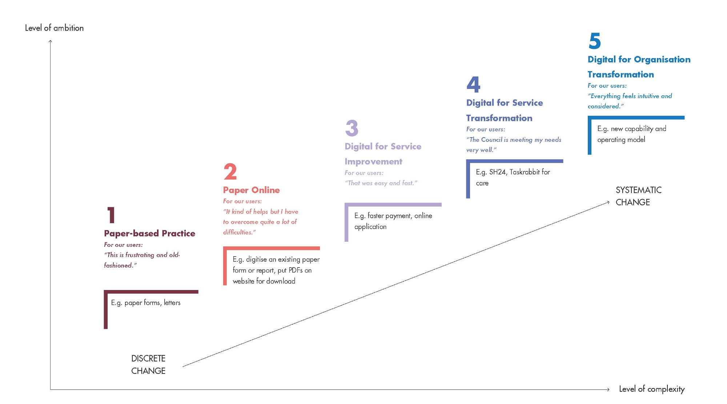
Notes:
End users take a slice of the information layer likely every day when they look up information and images, or complete forms online or on a mobile device.

Slide 25
Digital Service:
Organizational Maturity Determination

Slide 26
Digital Service Maturity Determination
It is critical for the contracting professional to be able to increase the chance of acquisition success by identifying and mitigating potential performance risks. One method of doing this is to understand the organizational maturity of how culturally ready for digital service implementations the requiring activity is in order to develop an acquisition strategy that aligns appropriately.
Why does it matter? An organization that has never worked with these kinds of services might find it difficult to jump right to running a complex coding challenge as part of a solicitation, awarding a large multiple vendor IDIQ/BPA, or knowing how to track and measure success of contract performance in a way that corresponds to delivering the best business value to the end users. Likewise, a mature digital service government team can define and evaluate solution providers to find the kind of company they want to build a solid team and relationship with instead of just finding a company that can hire to projects well.

Slide 27
Digital Service:
Analyzing a need

Slide 28
Analyzing a need
The MAP Mission:
Establish, publish, and enforce policy for the federal government regarding allowable literary practices, formats, and techniques in official government documents and agency records.
Notes:
Come up with 3 potential sources of supply and come up with 3 things we need to know to pick one of these things -- so people learn / follow

Slide 29
Analyzing a need
MAP accomplishes this mission by:
  Collecting and screening published, written work product content developed by employees of all federal government agencies employees for 1) violations of established literary policy, and 2) analysis of emerging literary trends. This includes federal agency reports, regulations, policies, and other content published and available for government and public consumption on federal websites.
  Reviewing requests from government agencies and private sector entities for use of non-compliant literary practices, formats, and techniques.
Notes:
Come up with 3 potential sources of supply and come up with 3 things we need to know to pick one of these things -- so people learn / follow

Slide 30
Analyzing a need
MAP’s secondary mission is to provide the private sector, which includes industry and private individuals, complete information on current government writing practices so that they can effectively communicate with government agencies in the written word
Notes:
Come up with 3 potential sources of supply and come up with 3 things we need to know to pick one of these things -- so people learn / follow

Slide 31
Analyzing a need
Existing conditions and other information
MAP has an existing proprietary application in place supporting their mission called Communication Options, Written Services System (COWSS). It has a web interface for the users (agency employees and customers) and fixed (uneditable), web-based forms for both customers and case worker employees at the agency.
The data fields in these forms are linked to an Oracle database built for COWSS that helps the employees perform their MAP mission and provides basic metrics for employees, supervisors, and senior leadership. MAP has had to purchase an Oracle enterprise license to run the database and receive patches/upgrades to Oracle.
Notes:
Come up with 3 potential sources of supply and come up with 3 things we need to know to pick one of these things -- so people learn / follow

Slide 32
Analyzing a need
COWSS also has the ability to accept user-generated attachments such as MS Office files and pdfs, as well as the ability to generate various reports and metrics based on an established set of data fields in the system.
COWSS’ is a proprietary software solution built by the contractor (Niagra Overpriced Software Enterprises or “NOSE”)
COWSS was developed using waterfall development and cost $6.6M over three years to develop and deploy on MAP agency servers.
The COWSS user interface has been optimized for laptops or desktops using Microsoft Internet Explorer.
The text editing and publishing features of the system run off of Adobe Acrobat and Microsoft Office Suite applications.
NOSE built interfaces integrate and connect the various different pieces of software that comprise the COWSS application. COWSS also interfaces with both internal MAP agency systems and the external systems of other federal agencies The interfaces between the systems were built by NOSE
Notes:
Come up with 3 potential sources of supply and come up with 3 things we need to know to pick one of these things -- so people learn / follow

Slide 33
Analyzing a need
Hypothesis:
By improving the underlying technology solution for the system that provides government and private sector customers a way to submit written content for review, request, and receive guidance on approved literary formats and protocols, customers have easy, intuitive, and immediate access to all appropriate MAP content, real time status of their cases, and follow-up which will improve the quality of published government literature.
Notes:
Come up with 3 potential sources of supply and come up with 3 things we need to know to pick one of these things -- so people learn / follow

Slide 34
Analyzing a need
Assumptions:
The system will need to provide flexibility to rapidly incorporate and integrate new data fields, forms, and web-site organization/presentation in support of changing mission processes, data needs, workload management and metrics/reporting needs, and government transparency policies.
End users will want to access this system on both mobile and web formats.
The current system will not be able to handle the requests of end users beyond the year without a change.
Notes:
Come up with 3 potential sources of supply and come up with 3 things we need to know to pick one of these things -- so people learn / follow

Slide 35
Analyzing a need
Product Vision:
This product will enable government and private sector customers with the ability to create and receive real time feedback on compliant government documentation which adapts to current literary trends and protocols.
Notes:
Come up with 3 potential sources of supply and come up with 3 things we need to know to pick one of these things -- so people learn / follow

Slide 36
Analyzing a need
Activity:
Using the scenario information and the Product Vision provided, analyze the digital services need to determine what services or products in the digital marketplace already exist and may be useful in satisfying the MAP agency needs.
Explore whether open source, proprietary, or COTS will be most effective. Consider this with the Federal Source Code Policy instructions about the three step Software Solution Analysis which states, “agencies must consider open source, mixed source, and proprietary software solutions equally and on a level playing field” in mind.
As a Contracting Officer, you need to be able to understand the differences between these types of solutions and where they exist in the market.
Notes:
Come up with 3 potential sources of supply and come up with 3 things we need to know to pick one of these things -- so people learn / follow

Slide 37
Sources of supply:
Contractual vehicles

Slide 38
Contractual vehicles
In addition to finding a commercial supplier to provide the digital service to your agency, there are also many government contract vehicles you can utilize to acquire many of those same services. Once you have identified a need and understand the requirement to meet that need, where can you buy it? The below list is not exhaustive, but it is a comprehensive list of the most common vehicles (methods) for buying services for the government.
  Direct to market (open competition)
  Government-wide contracts (SEWP, OASIS, Agile BPA, etc.)
  Federal Supply Schedules (GSA Schedules)
  Non-traditional platforms (brokers, FedBid, Amazon, etc.)
  Other Transaction Agreements (shared services)

